Slide 1

Cars Price Predict Project
Submitted by:
Rahul singh

Slide 2
ACKNOWLEDGMENT
Thanks for giving me the opportunity to work in FlipRobo Technologies as Intern and would like to express my gratitude to Data Trained Institute as well for training me in Data Science Domain. This helps me to do my projects well and understand the concepts.
Dataset – FlipRobo Tech
Resources used – Google, GitHub, Blogs for conceptual referring.

Slide 3
Business Problem
With the covid 19 impact in the market, we have seen lot of changes in the car market. Now some cars are in demand hence making them costly and some are not in demand hence cheaper.
One of our clients works with small traders, who sell used cars.
So, we must predict the used cars price predict for our client through machine learning models.

Slide 4
Conceptual Background of the Domain Problem
With the change in market due to covid 19 impact, our client is facing problems with their previous car price valuation machine learning models.
Some cars are in demand and making them costly and some are not in demand, and it will be cheaper.
This will help our client to do better trade and help in his/her business to grow.

Slide 5
Motivation for the Problem Undertaken
Car is one of the most needed in everyone lives, and all people cannot afford to buy a new one and people who want to buy can exchange their old car in a good rate.
Our Prediction will help the client to sell the car in a smart way.

Slide 6
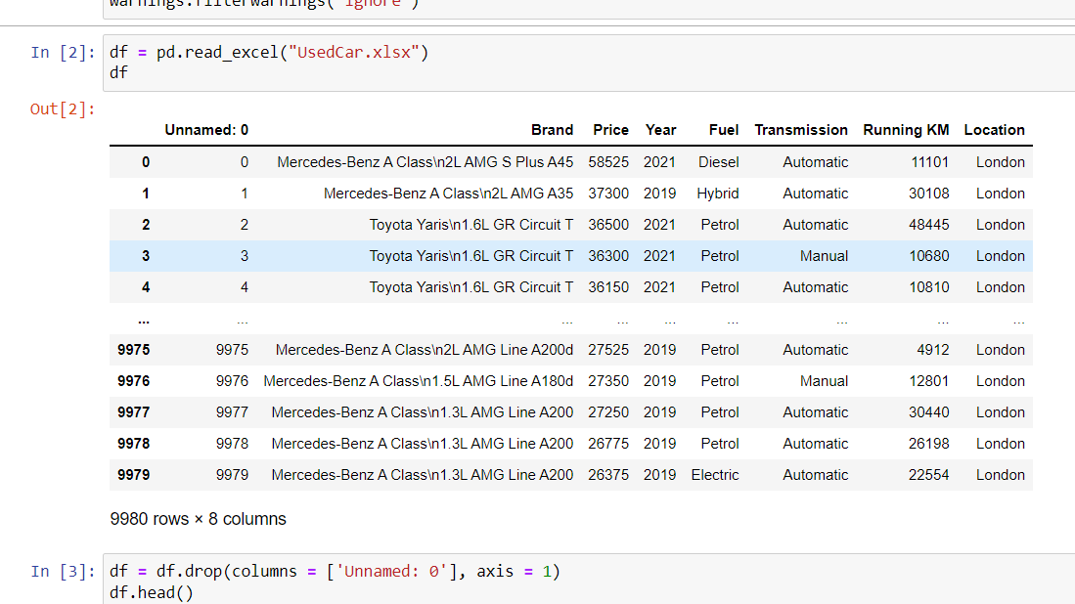
Data Sources and their formats
The data is collected from One of the famous websites for used cars and price are in Euros and it has 8 columns and 9980 rows.

Slide 7
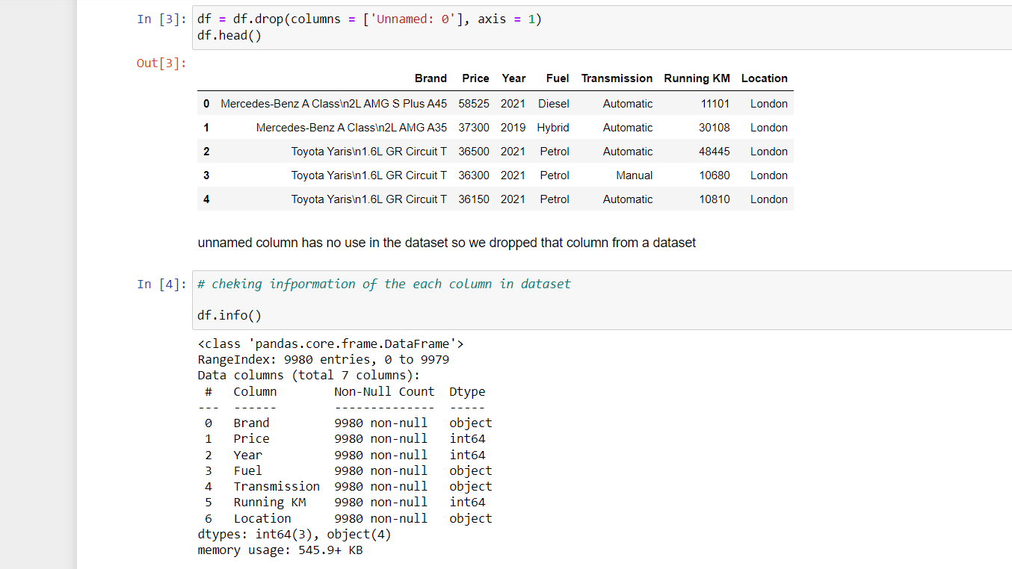
Data Pre-processing Done

Slide 8
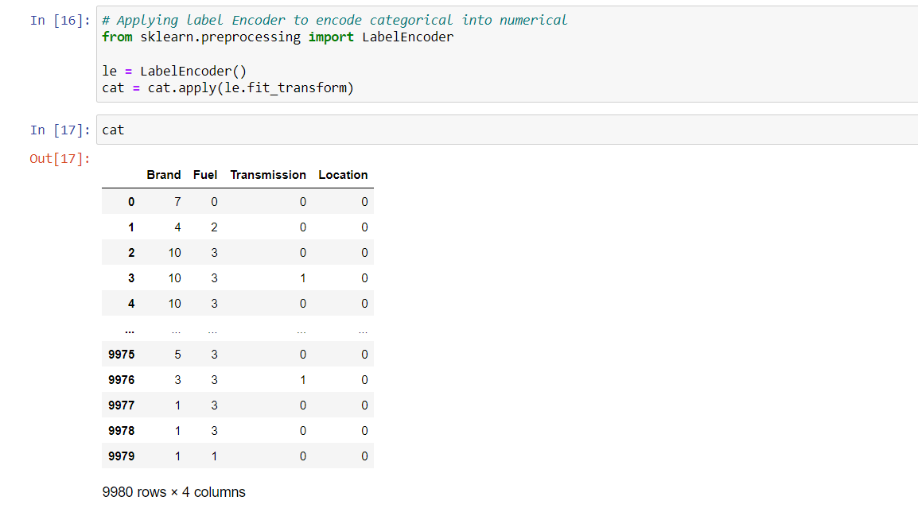

Slide 9
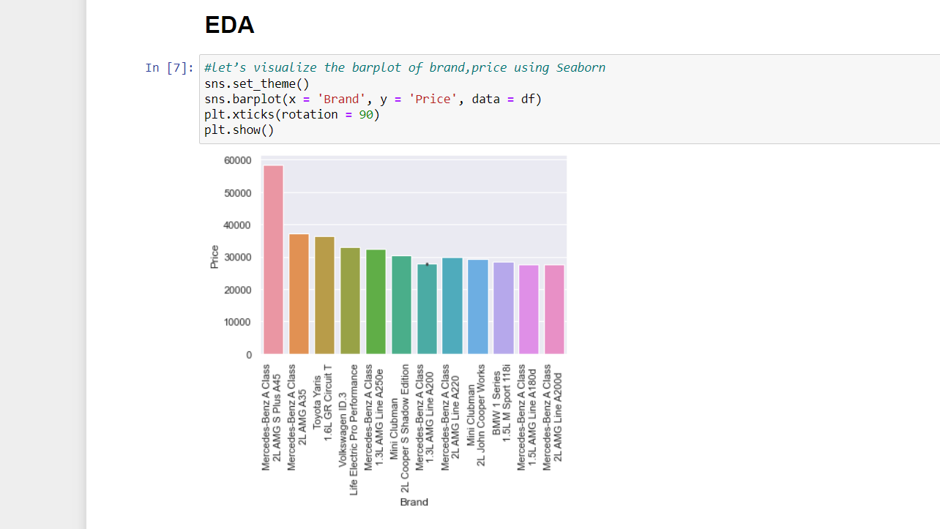
Data Visualization
Almost all car brands are in demand but among all popular brands, Mercedes, Toyota and BMW are having high price than other brand cars.

Slide 10
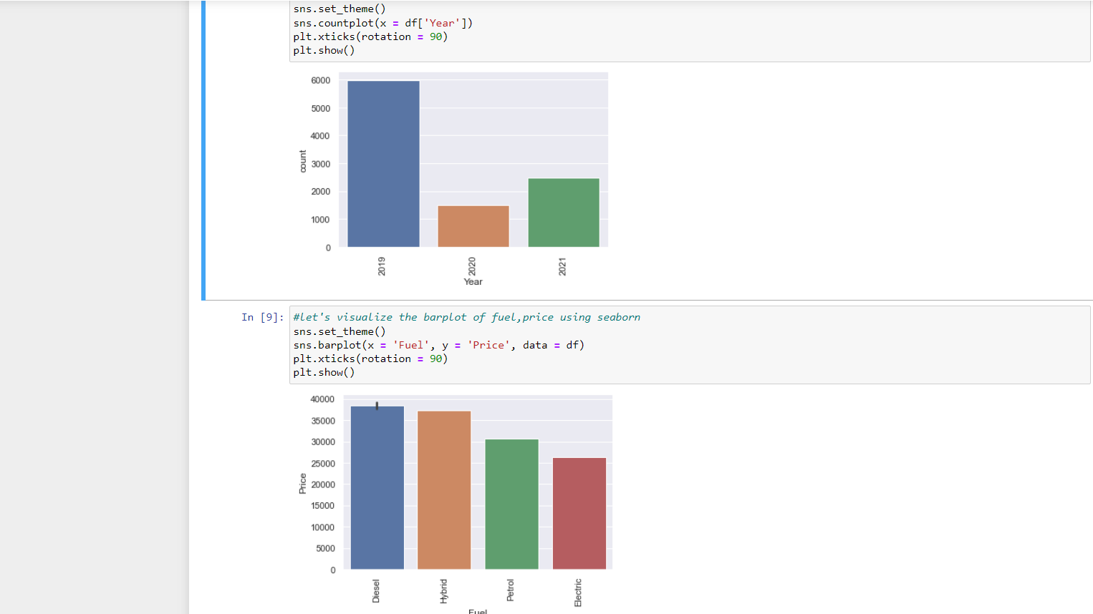
We can see from the below plot that most of the car registered year is from 2019, 2020 and 2021.
Also, most of the cars are having fuel type is Electric , Diesel and petrol.

Slide 11
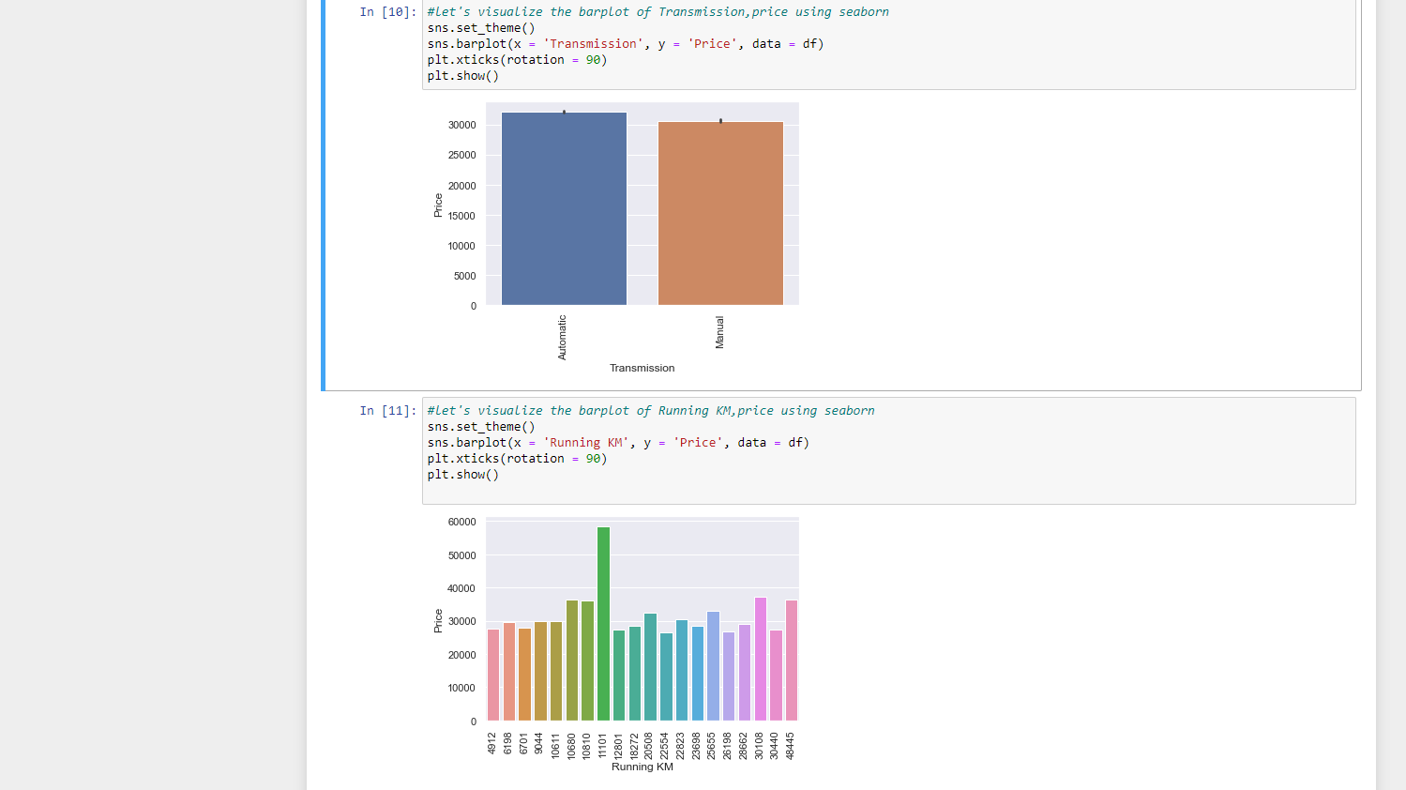

Slide 12
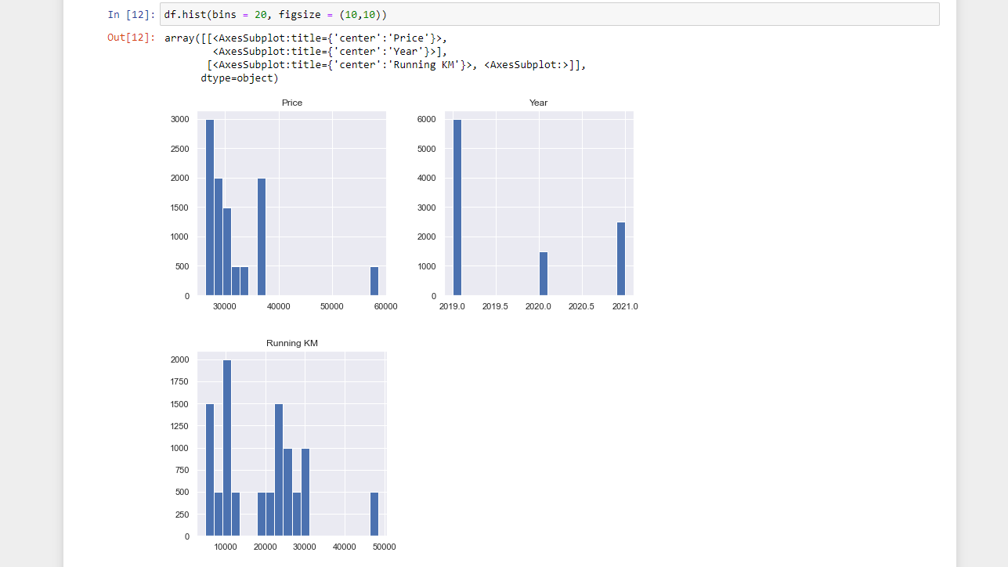
Data Visualization

Slide 13
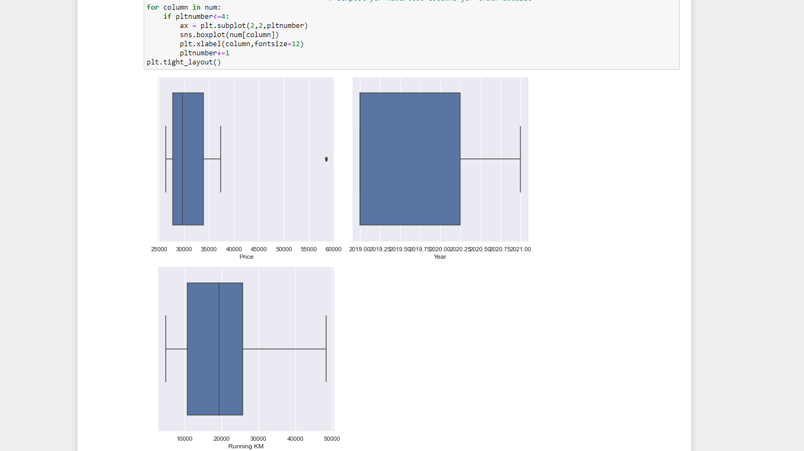
Data visualization

Slide 14
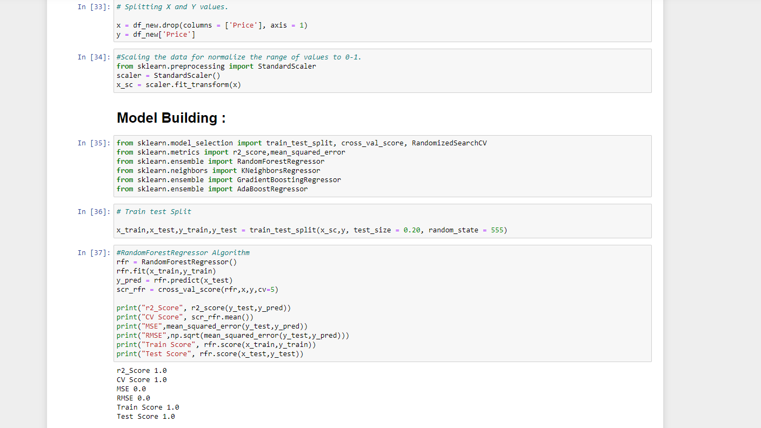
Standard-Scalar is applied to standardize the input data. Splitted the train and test data for model building,

Slide 15
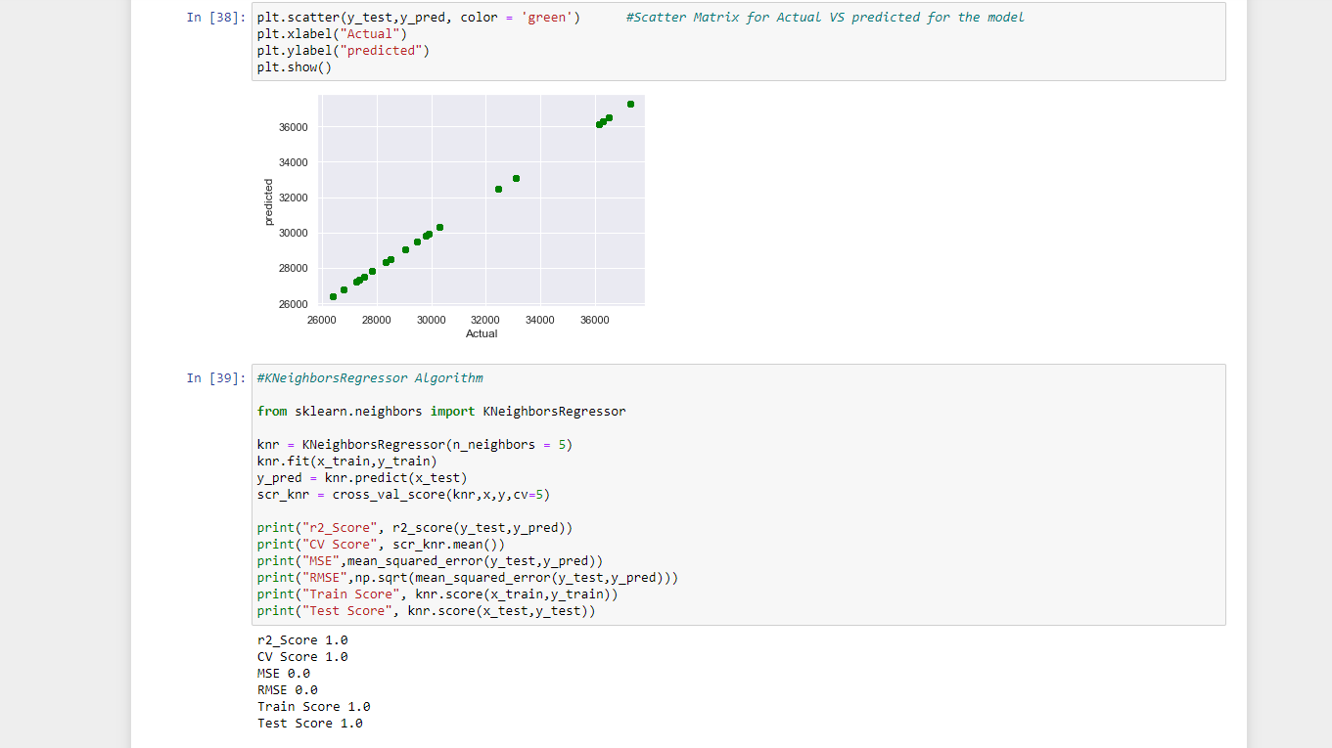

Slide 16
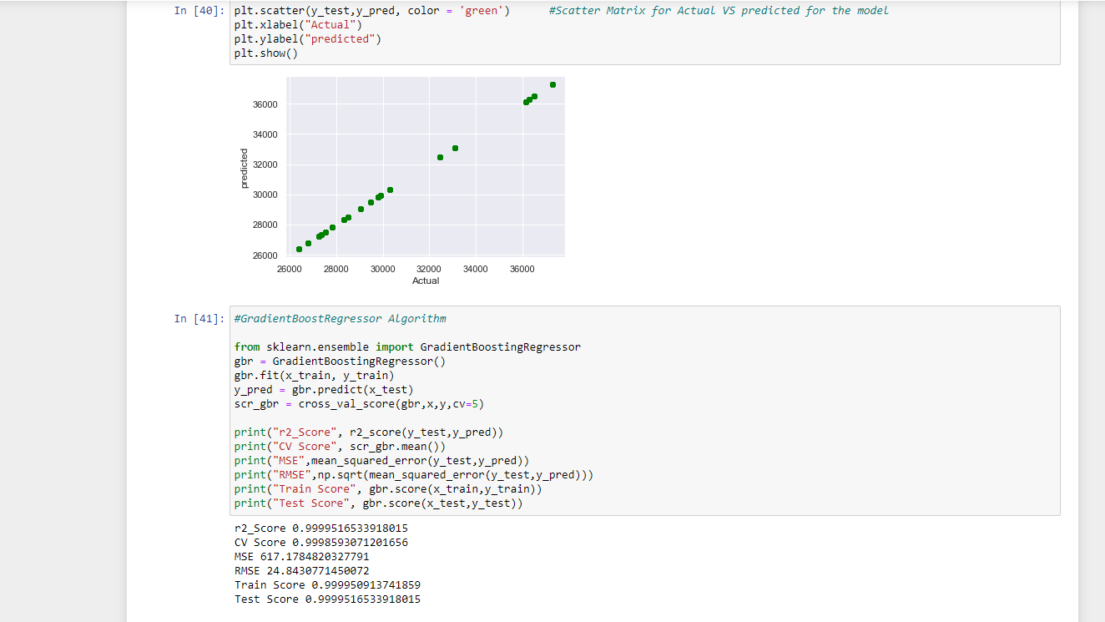

Slide 17
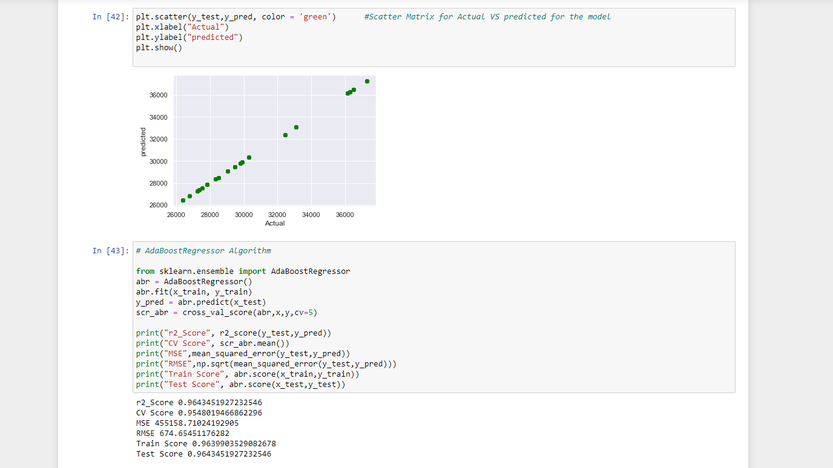

Slide 18
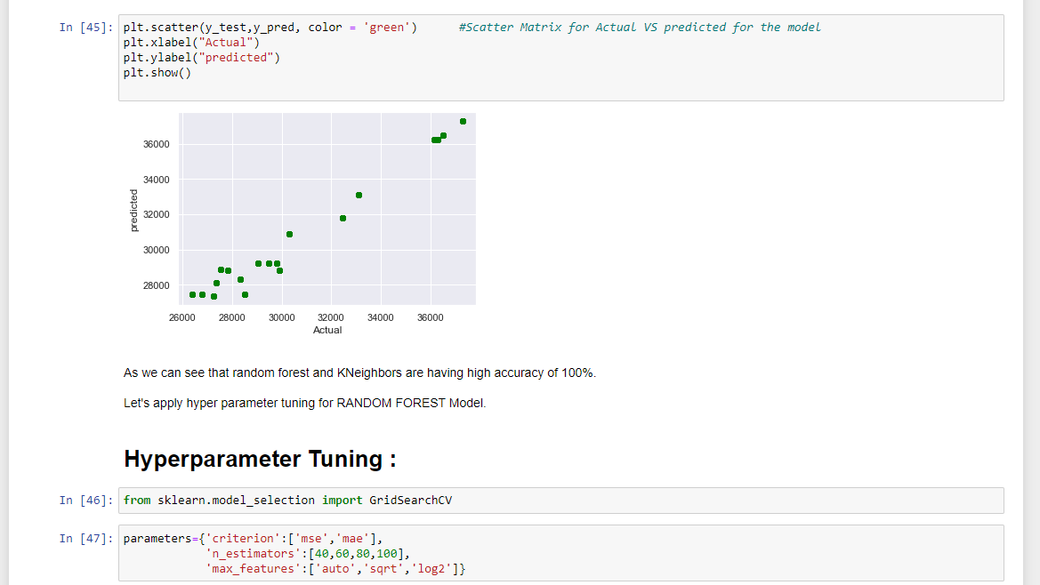

Slide 19
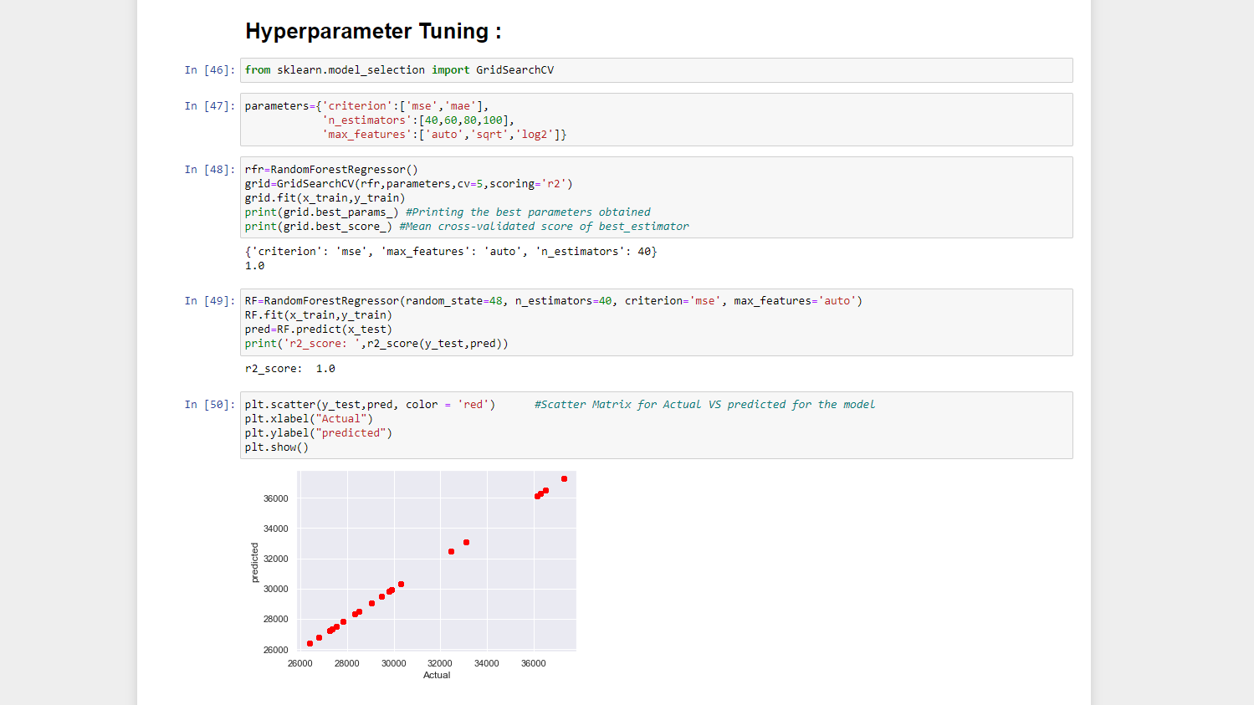

Slide 20
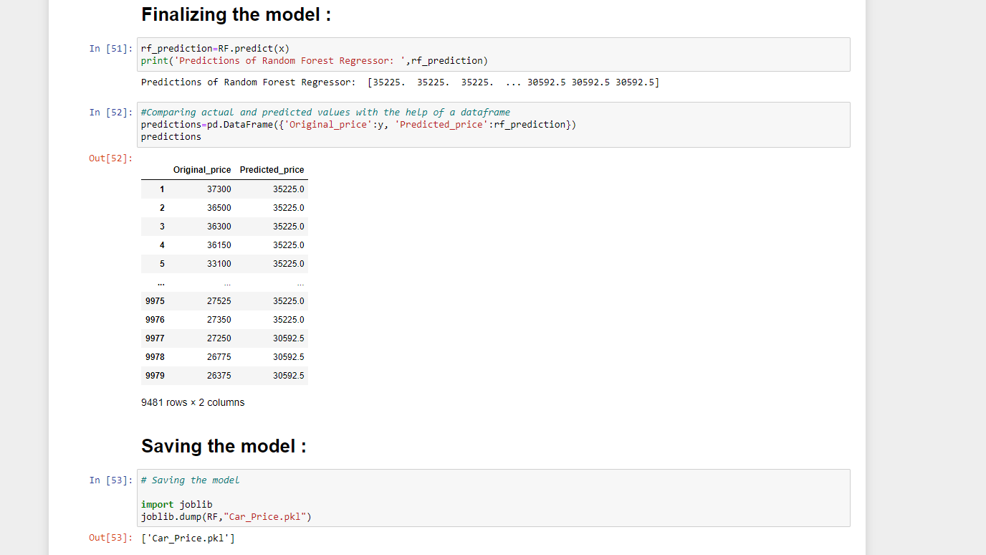
Finally Saving the model .pkl file and Loading the test data File,

